Slide 2
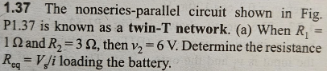
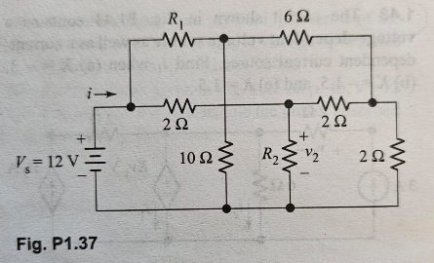

Slide 3
1. You Don’t “Reduce” Twin-T Networks
Twin-T circuits are not reducible using series/parallel tricks.
👉 They are meant to be solved using:
KVL
KCL
Known voltages/currents
2. Given One Voltage → Everything Falls Into Place
The moment you know one internal voltage, the circuit becomes transparent.
Analog intuition = propagate known quantities
3. Symmetry Is a Hidden Shortcut
The left and right branches are structurally identical.
This guarantees:
Same voltage drops
Predictable current splits
4. Think in Nodes, Not Resistors
Instead of staring at resistors, ask:
“What is the voltage at this node?”
“Where can current go from here?”

Slide 4
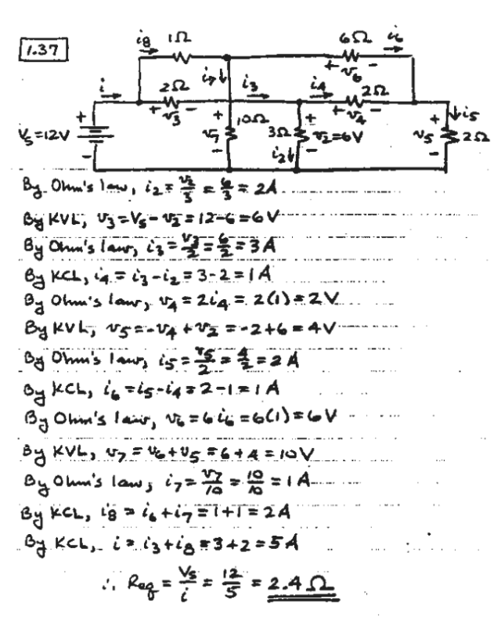

Slide 5
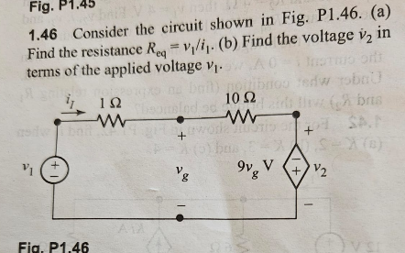

Slide 6
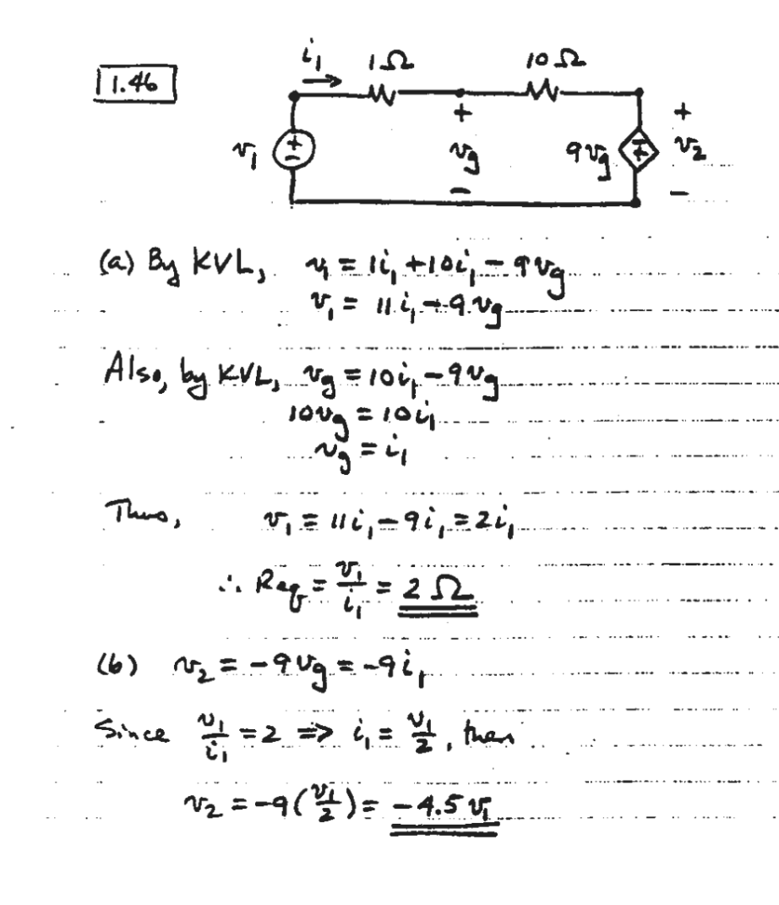

Slide 7
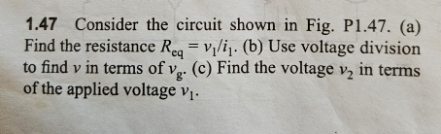
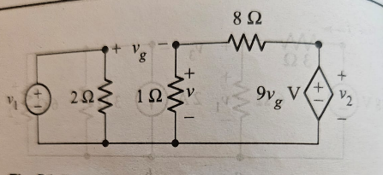

Slide 8
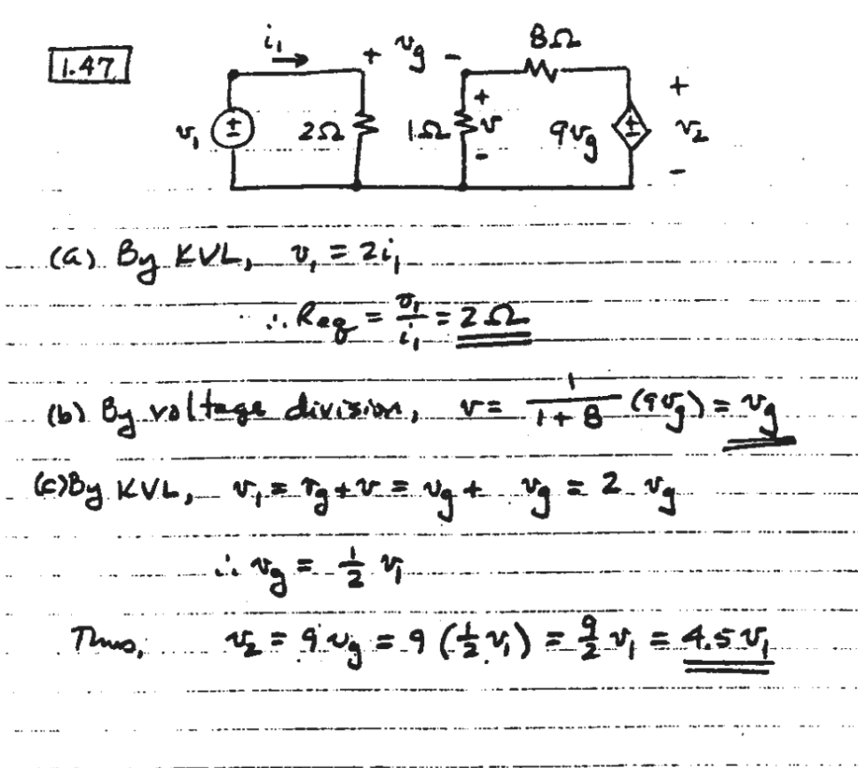

Slide 9
Intuition (This Is the Real Learning)
1. Equivalent Resistance ≠ “Whole Circuit”
Input resistance only depends on what the source sees.
If a dependent source is not directly loading the input node, it may not affect R_{eq}​.
2. Voltage-Controlled Sources Amplify Nodes
Here:
A simple resistor divider sets vg​
The dependent source magnifies that node voltage by 9×
This is how gain is created without op-amps.
🔑 Key Takeaways (Exam + Industry)
✅ Dependent sources must stay active when finding R_{eq​}
✅ Input resistance is a local property
✅ Voltage-controlled sources create gain
✅ Many “mysterious” networks are just implicit amplifiers
3. Think in Nodes, Not Branches
Instead of chasing currents everywhere:
Identify controlling voltages
Express everything in terms of them
That’s how analog designers simplify complexity.
4. This Is a Hidden Amplifier
Even without an op-amp symbol:
v₂​=4.5v₁​
Power comes from the dependent source
This is the foundation of active circuits, filters, and oscillators.

Slide 10
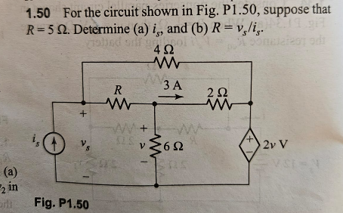

Slide 11
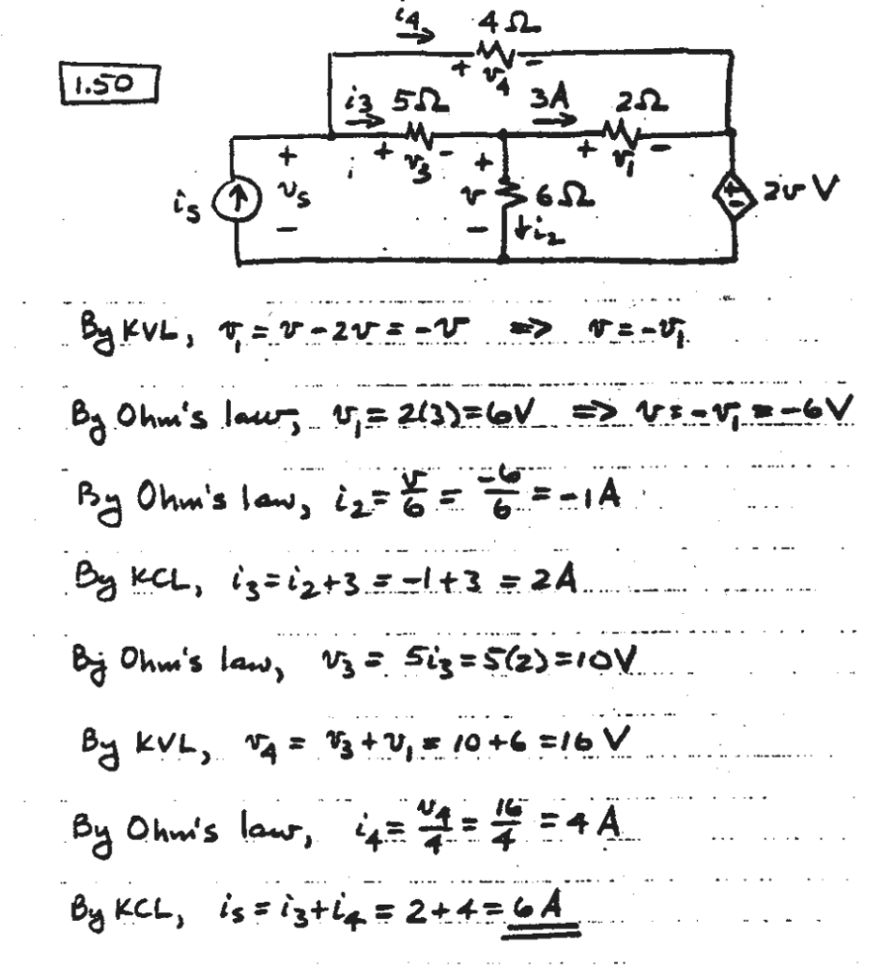

Slide 12
Deep Intuition (This Is the Key Learning)
1. Dependent Sources Control the Circuit
The dependent voltage source locks the right node voltage, which then:
Forces current through 2Ω
Fixes the middle node voltage
Controls all branch currents
👉 One voltage controls the entire network.
2. Current Sources Define Voltages
The 3 A current source doesn’t ask for permission.
It says:
“I will push 3 A, and whatever voltage is needed will appear.”
That voltage becomes the control signal for the dependent source.
3. This Is a Hidden Feedback System
Notice:
Current → Voltage (6Ω)
Voltage → Dependent Source
Dependent Source → Node voltages
Node voltages → Currents
That’s feedback, without op-amps.

Slide 13
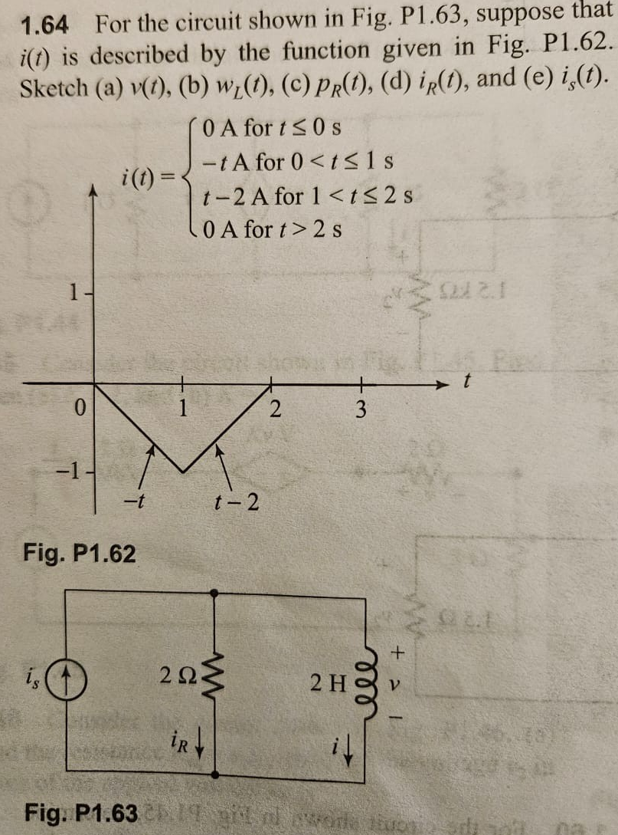

Slide 14
Most important habit
Before touching equations, ask three questions:
What kind of elements do I see?
→ Resistor + Inductor → energy storage + dissipation
Series or parallel?
→ Parallel → same voltage, current splits
What is the input?
→ Current source → KCL is your friend
“Your job is not to calculate.
Your job is to choose the right variable.”
Here, the right variable is the inductor current.

Slide 15
Problem Roadmap
Identify the state variable
Write one governing equation
Solve piecewise
Derive all other quantities by physics, not math
Sketch waveforms using rules, not formulas

Slide 16
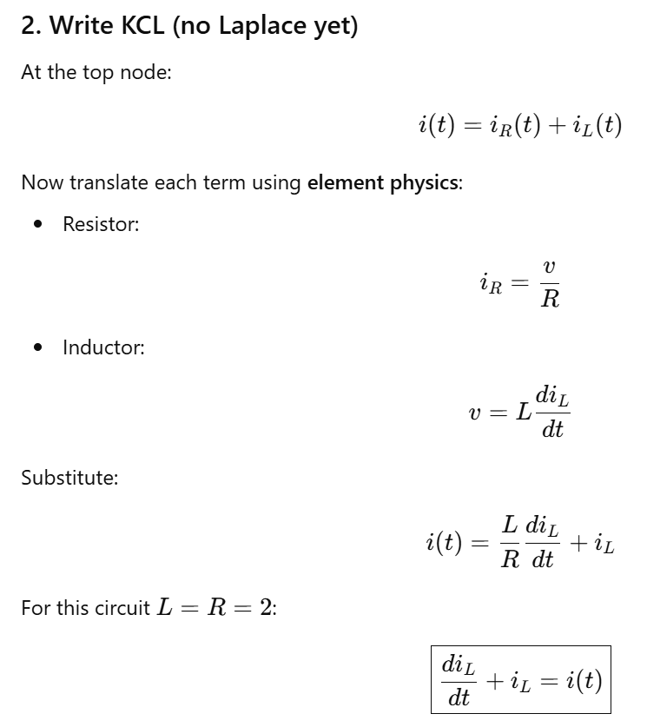
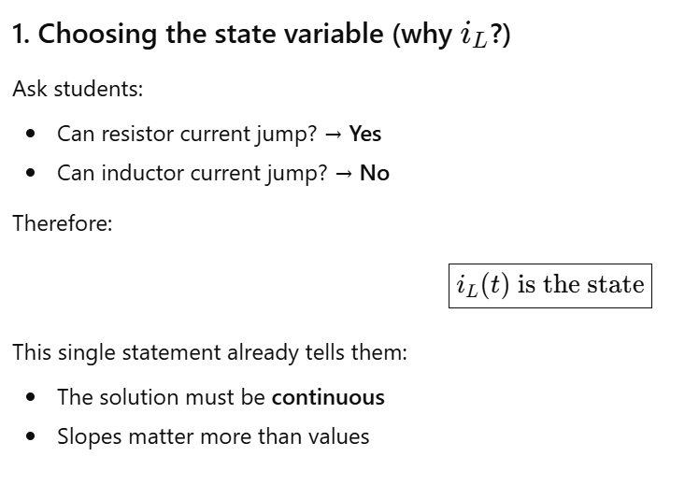
“Every RL circuit hides this equation. Find it.”

Slide 17
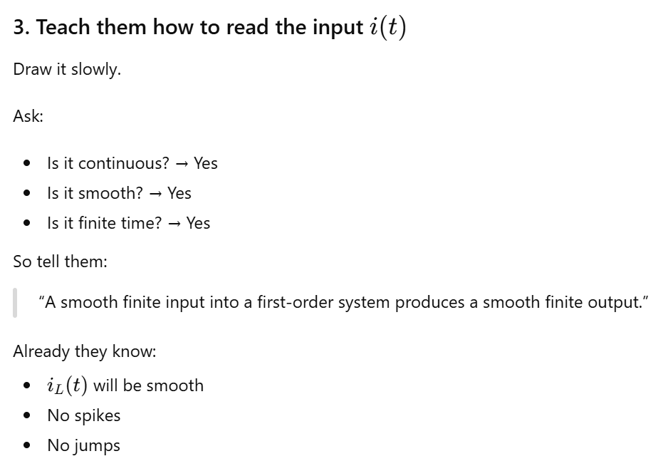
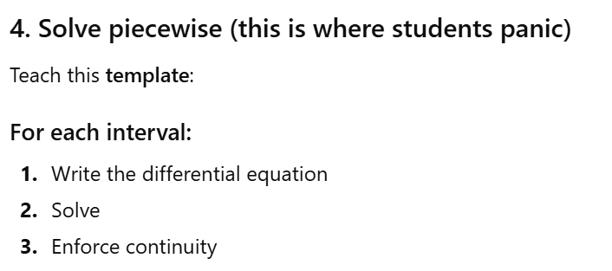

Slide 18
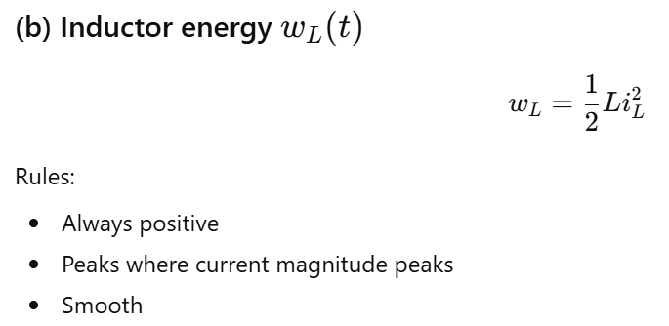
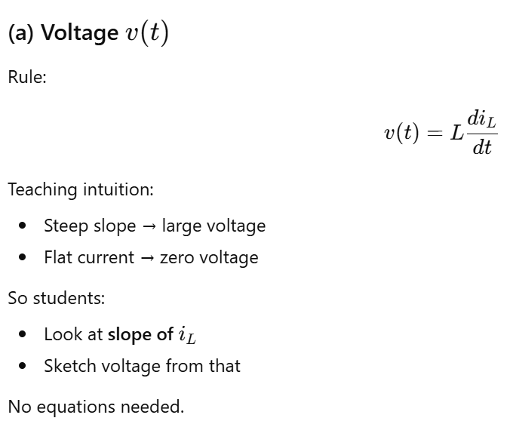
How to Sketch Each Quantity (THIS is gold)
“Energy ignores sign. Only size matters.”

Slide 19
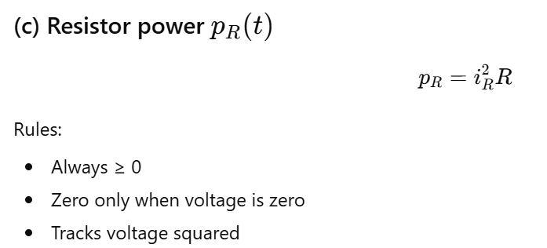
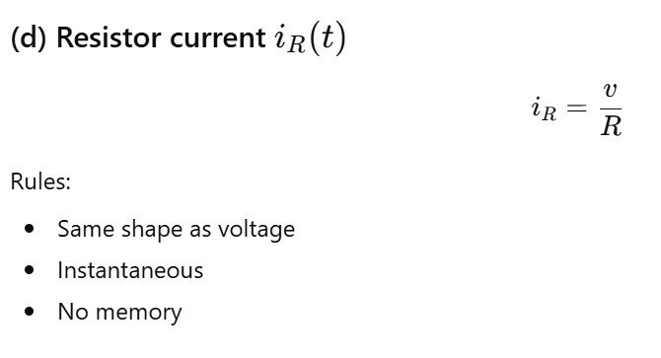
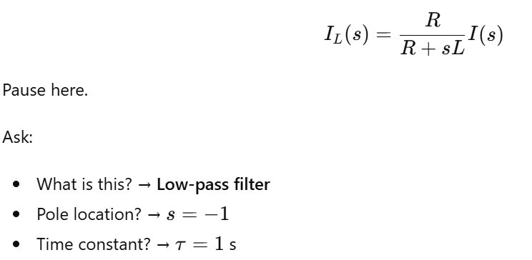
“Power is where energy disappears.”
Laplace domain (how to teach it intuitively)
Start with why Laplace exists:
“Laplace turns memory into algebra.”

Slide 20
What examiners actually want
Correct choice of state variable
Correct continuity conditions
Correct qualitative waveforms
Not algebra gymnastics
Final Summary
RL circuits are not math problems.
They are energy flow problems.
Resistors forget.
Inductors remember.
Sources command.

Slide 21
